Slide 2
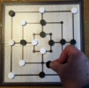
1.1 Nine men’s morris - Mill (Board Game)
Aims:
Participants should be taught to count reliably up to 9 items.
They understand that if items are rearranged the number stays the same.
They know how to count on and back from any small number

Slide 3
1.1 Nine men’s morris - Mill (Board Game)
Comments on the Course:
Lesson 45 Minutes, take a board for each 3 players
The game was chosen, because 9 is the biggest single digit number.
Explain the game “Nine men’s Morris”
Make groups of three participants: one is watching and helping the game, two are playing. The participants play several times the game "Nine Men's Morris". They always have to begin with 9 men. The Players have fun and they win the game sometimes. This makes them feeling self-confident.
The participants learn to count up to 9 by putting the men to the board.
On the worksheet they mark the men with numbers.
They learn that the last number when counting is the number, which represents the amount of the men.
The participants learn, that 9 men are 3 mills, each mill exist of 3 men.

Slide 4
1.1 Nine men’s morris - Mill (Board Game)
Hints
If the participants cannot read, the teacher has to guide them.
If participants have difficulties to count, you have to train – you need more time or you can split the group.
If participants have difficulties to write numbers, you have to divide the lesson into two lessons: First lesson: play and count, second lesson: play and write numbers.
Following lesson: Look for another game, in which the participants have to count up to 9.

Slide 5
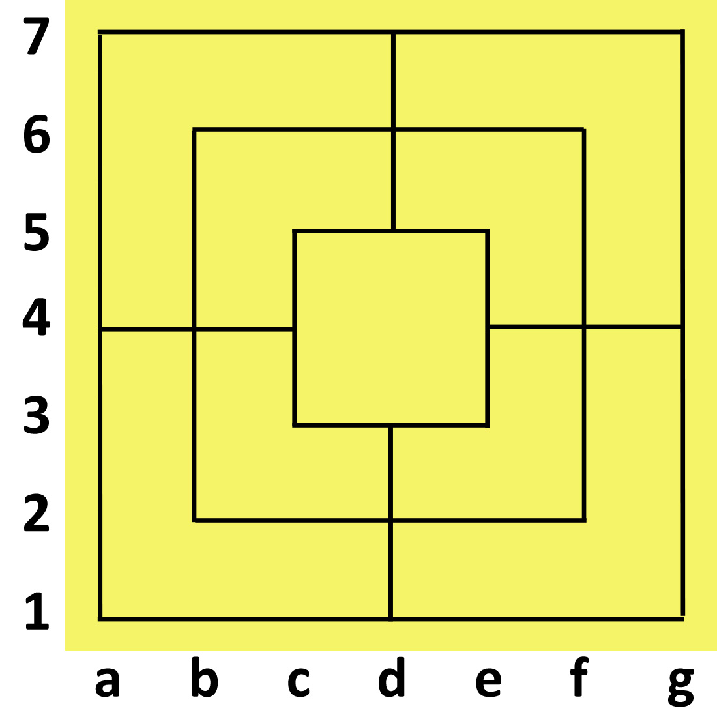

Slide 6
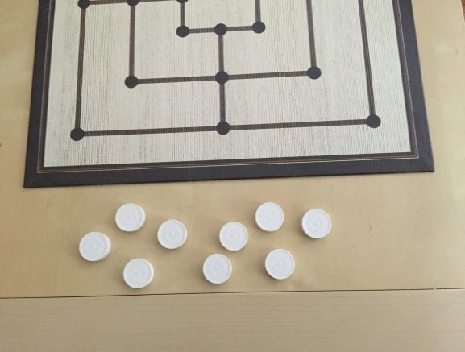
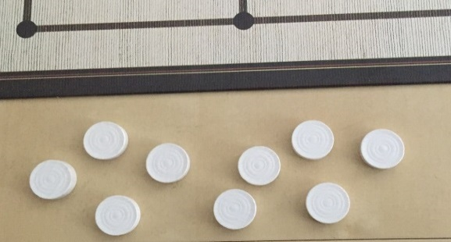
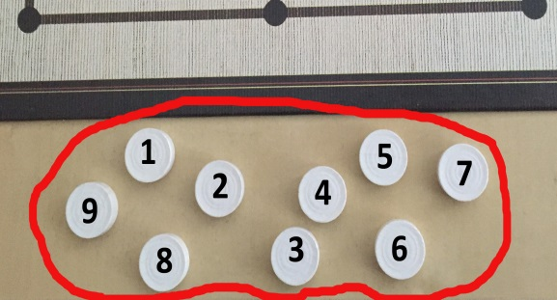
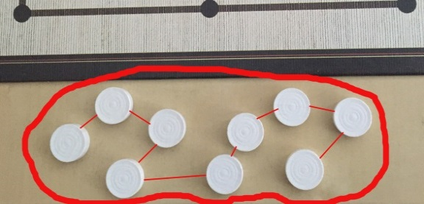
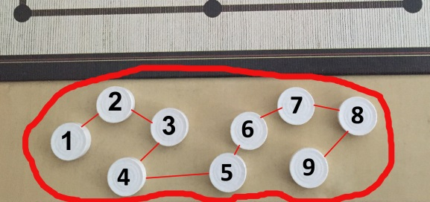
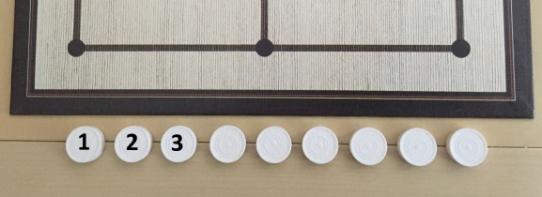
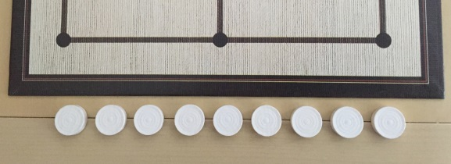
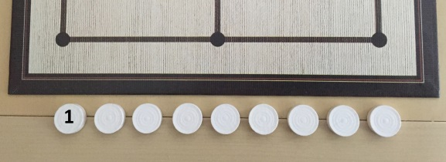
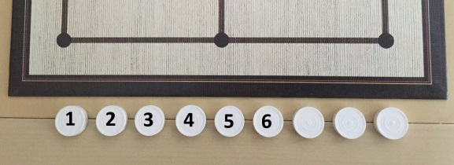
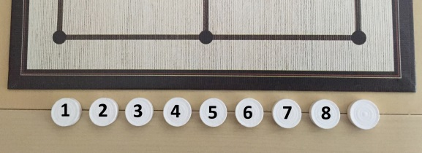
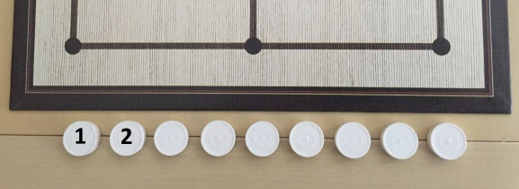
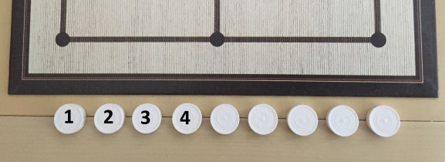
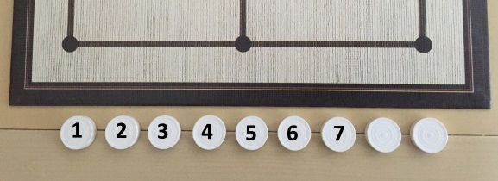
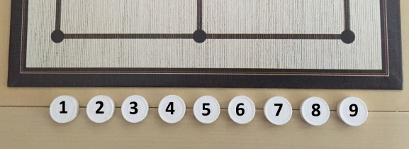
1.1 Nine men’s morris - Mill (Board Game)
You start the game Nine Men’s Morris with 9 men for each player.
Are you sure, these are nine men?
Yes!
Count the men again and write numbers on them!
1 2 3 4 5 6 7 8 9
The last number is 9
Give each man a number according to the lines! Start on the left side!
The last number is the amount of the men.
How many men are all together?
9 - because the last number during counting is 9.
Give each point on the line a number:
You have got a number-line and the numbers are sorted, they are in an order!

Slide 7
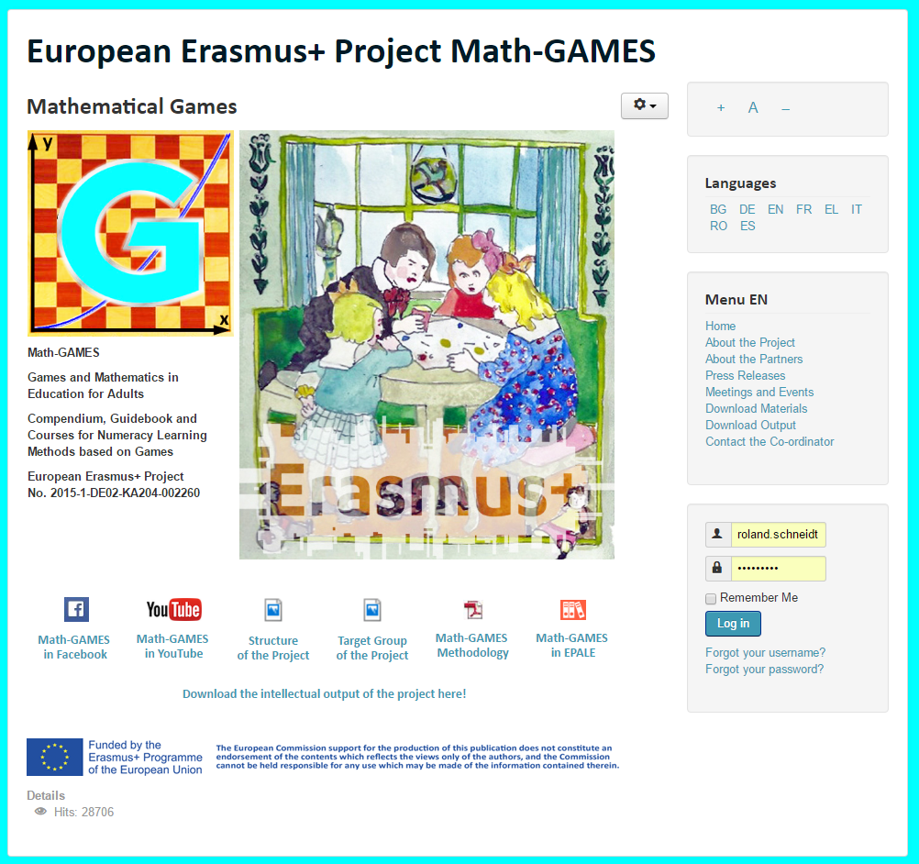
The result is: Play Games and and learn Mathematics more easily.
Our Project-Website will help you: www.math-games.eu

